Slide 1
ISB 120
LECTURER NAME:
MULENGA MPOLOKOSO
(Ph.D_WIP, MBA, BBA, BICTED, BSCFO, TM, ISP, CMP)

Slide 2
Unit 4: The Firm and Production
⦁ Production functions: short-run versus long-run considerations
⦁ Cost analysis: fixed costs, variable costs, and total costs
⦁ Profit maximization and the relationship between costs and revenue
⦁ Market structures: perfect competition and monopoly
⦁ Pricing strategies and the impact of market power
⦁ Profit and revenue in different market structures
⦁ Economies of scale and scope in production
⦁ Technological advancements and their influence on production
⦁ Innovations and their role in business strategies
⦁ Labor markets and the economic implications of wage differentials

Slide 3
Production functions: short-run versus long-run considerations
In this lecture we look at firms and production.
A firm is simply some organization that takes inputs and turns it into
outputs.
We can roughly divide these firms into
private sector
public
non-profit firms

Slide 4
Ownership and Management of Firm
1. Sole proprietorship
owned by an individual who is responsible for all debts.
Example: A freelance writer or a bookkeeper.
2. General partnership
Jointly owned by multiple people who are together responsible for
debts.
Example: Law office with multiple partners.

Slide 5
Ownership and Management of Firm
3. Corporations
Owned by shareholders in proportion to the amount of stock they own.
limited liability.
Example: Microsoft, recently Facebook.

Slide 6
Ownership and Management of Firm
Private firms have the single goal of maximizing profits.
Profit (p) is defined as total revenue (TR) minus total cost (TC).
p = TR - TC
TR = p *q
A firm can only maximize pro.t if it achieves technical efficiency.
Technical efficiency means they get the most output they possibly can
from their set of inputs and technology.
Note: * Implies Multiplication

Slide 7
Production
A firm takes inputs (factors of production) and turns it into output
according to its technology.
We can broadly classify these inputs into capital (K), labour (L) and
materials (M) (which we usually ignore for simplicity).
The production function summarizes this process, and tells us
exactly how much output the firm can get from their inputs.
For example suppose our production function is
q = f (L,K) = 2 * L* K
If the firm employs two units labour and 4 units of capital it gets 16
units of output (it could produce less, but that would not be efficient).

Slide 8
EXAMPLE
Suppose a firm produces output using only labour according to the
production function q = L^2.
Sketch this production function and identify two production plans,
one that is technically efficient and one that is not.
The short run is the period of time that at least one factor of
production cannot be changed.
For example, dominoes can decide how many delivery drivers it hires
in a month, but can.t decide how many stores to build in this time
frame.
12

Slide 9
Production
The long run is a period of time in which all inputs can be varied.
The difference between short and long run varies by industry.
We call inputs that can.t be changed fixed inputs, and ones that can
be changed variable inputs.
Lets say capital is fixed in the short run, our production function is
then
q = f (K, L)

Slide 10
Production
Suppose our production function is q = 2KL, but capital is fixed at
K = 4 in the short-run.
Our short-run production function becomes q = 8L.
We can summarize the relationship between output and the amount
of labour used by the total product of labour, the average
product of labour and the marginal product of labour.

Slide 11
Short-Run Production
Total product of labour is the amount of output that a given
amount of labour can produce holding other inputs fixed
Marginal product of labour is the extra output you get from
increasing labour by some infinitesimally small amount
MPL =dq/dL
Average product of labour is the amount of output produced per
worker
APL =q/L

Slide 12
EXAMPLE
Suppose our production function is
Q = K*L^2
What is the total product of labour, marginal product of labour and
average product of labour if capital is fixed at 50?
If our short run production function is q = L + 30L^2 – L^3
See graph in Next Slide

Slide 13
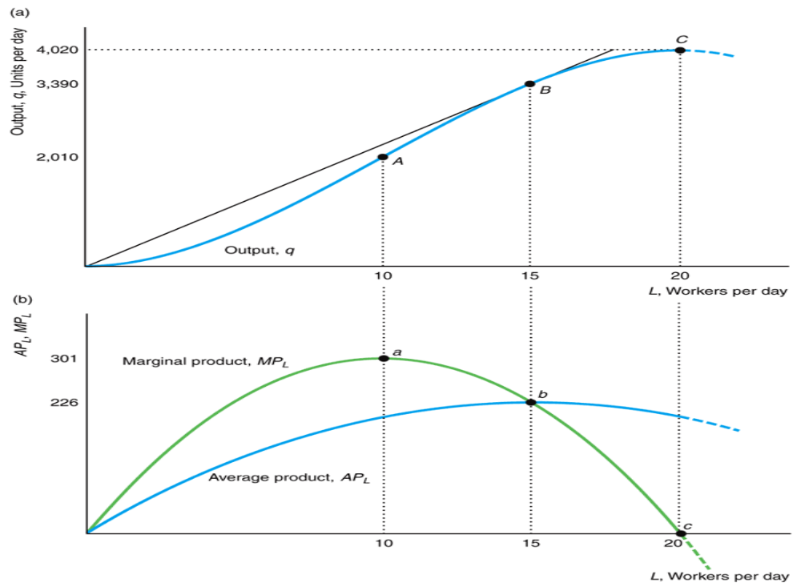
Short-Run Production

Slide 14
Short-Run Production
We assume the firm can hire fractions of workers (which is why this is
smooth)
The MPL is the slope of the production function
The APL is the slope of the chord from the origin
The previous production function is typical
APL initially rises because of gains from specialization, but it declines
because capital is held constant.

Slide 15
Short-Run Production
The MPL always intersects the APL at the maximum of the APL
curve.
When MPL > APL, the average is pulled up.
When MPL < APL, the average is pulled down.
EXAMPLE
Lets prove together that MPL = APL at the maximum of APL for
the production function q = L + 30L^2 – L^3.

Slide 16
Short-Run Production
The law of diminishing marginal returns is huge in economics.
As you increase one input, holding all other inputs and technology
constant, the marginal returns to that input will decrease eventually.
The second derivative will become negative.
You can.t grow the worlds food supply in a flower pot.
This is why Malthus predicted mass starvation (one input -land- is
fixed).

Slide 17
Short-Run Production
For the production function
q = L + 30L^2 – L^3
MPL =dq/dL
q= 1 + 60L - 3L^2
The marginal product of labour is increasing for low levels of output
because of gains from specialization.
Eventually, the marginal product of labour starts to decrease.
dMPL/dL = 60 - 6L
L < 10 MPL increases
L > 10 MPL decreases

Slide 18
Short-Run Production
EXAMPLE
Suppose the worlds supply of food is determined by the production
function
F = M^1/2 *L^1/2
M is land and is fixed at 3600.
L is labour.
At what point does this production function exhibit diminishing
marginal returns to labour?

Slide 19
Long-Run Production
In the long run, the firm is free to select as much of any input...
nothing is fixed.
Lets suppose our production function is Cobb-Douglas
q = 3L^1/2*K^1/2
Try to graph this.
Now that we have multiple variable inputs, our production function
has multiple dimensions.
Can.t really deal with it graphically.
We can summarize this production function in 2 dimensions.

Slide 20
Long-Run Production
An isoquant is a curve that shows the efficient combinations of
inputs that produce a single level of output
This has a very similar interpretation to indifference curves.
Every combination of labour and capital on the same isoquant will
produce the same amount of output.

Slide 21
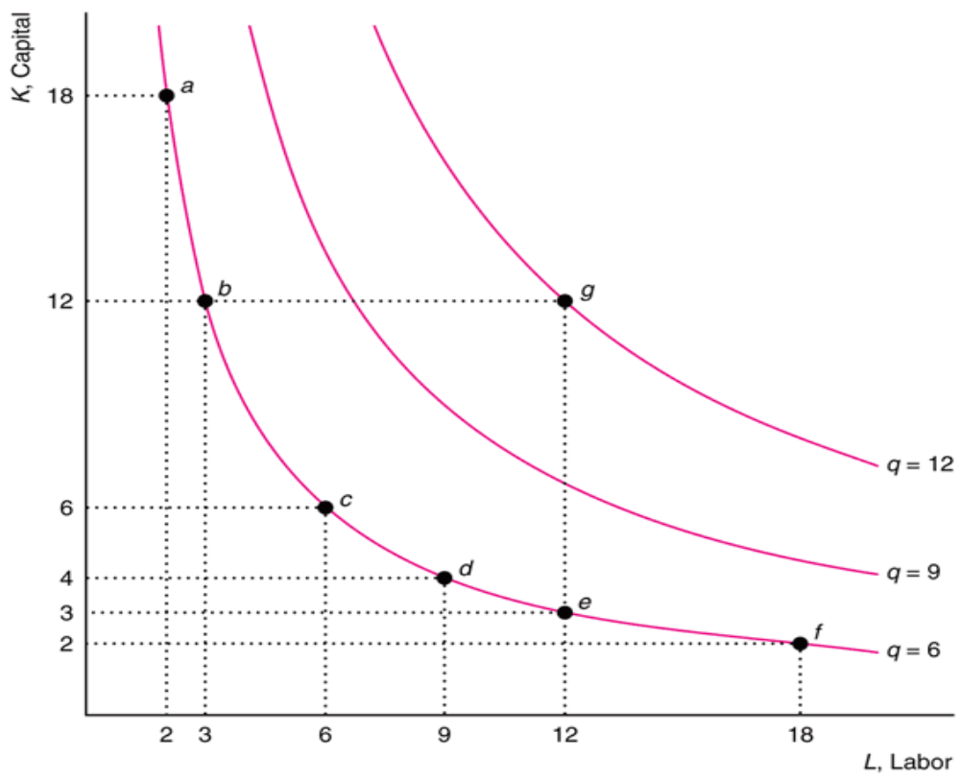
Long-Run Production

Slide 22
Long-Run Production
Say our production function is
Q = 10*K*L
Draw the isoquant for Q = 10 and Q = 20.
Lets now discuss the properties of isoquants.
1. Further from the origin, the greater the output
The more inputs you use, the more output you get if you are
producing efficiently

Slide 23
Long-Run Production
They cannot cross
Suppose the isoquant where Q = 20 and Q = 15 cross.
The firm could produce 15 or 20 units of output for the same input
combination.
The firm would not be efficient if it produced 15 for that input
combination.

Slide 24
Long-Run Production
They slope downward
If they sloped upward, the firm could produce the same level of
output with fewer inputs.
They are thin
If they were thick, the firm could decrease its input use and get the
same level of output
UNLIKE indifference curves, isoquants are a cardinal measure.
Output is objective, it is not some abstract thing like utility.

Slide 25
Long-Run Production
The curvature of the isoquant tells us how
substitutable/complementary the inputs are in the production process.
The more "curvy" the isoquant, the greater degree of
complementarity there is between inputs
If they are straight lines, the inputs are perfectly susbstitutable
(apples from Oregon or Washington). This would come from a linear
production function
q = x + y

Slide 26
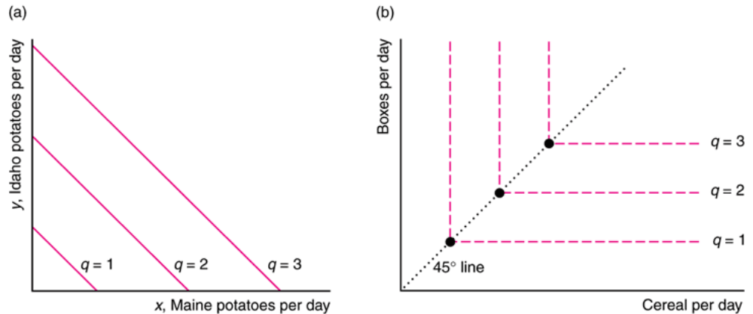
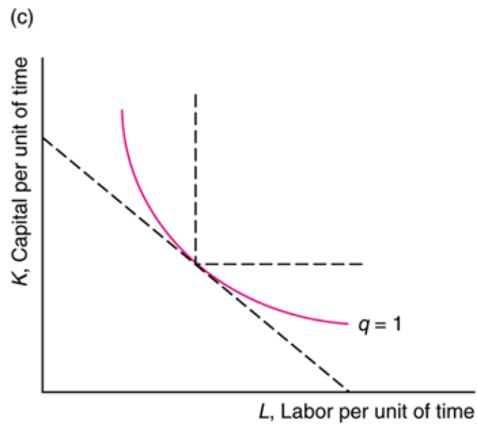
Long-Run Production-SUBSTITUTABILTY OF INPUT
If they are right angles, inputs must be used in fixed proportions (one
secretary per phone). this comes from a fixed-proportions production
function
q = min(x, y)

Slide 27
Long-Run Production
The slope of the isoquant shows the firms ability to replace one input
with another holding output constant.
This is called the marginal rate of technical substitution (MRTS) .
How much K can we give up for another unit of L holding output
constant.

Slide 28
Long-Run Production
Remember that the slope of an indifference curve is the negative ratio
of marginal utilities.
The slope of the isoquant (MRTS) is the ratio of marginal products.
MRTS =(dq/dL)/(dq/dK)= -MPL/MPK

Slide 29
Long-Run Production
EXAMPLE
Lets find the MRTS of
q = AL^a*K^(1-a)
Is the MRTS constant for this production function?
If we have normal convex isoquants, we have a diminishing marginal
rate of substitution
That is, when a lot of capital and little labour is used, the MRTS is
really high. When a lot of labour and a little capital is used, it is
really low.

Slide 30
Long-Run Production
Suppose we have a factory with 1,000,000 workers and only one
machine.
To keep output constant, we could trade one machine for a ton of
workers (because workers need machines)
As we get more machines, the number of workers we can trade for
one more machine will decrease.

Slide 31
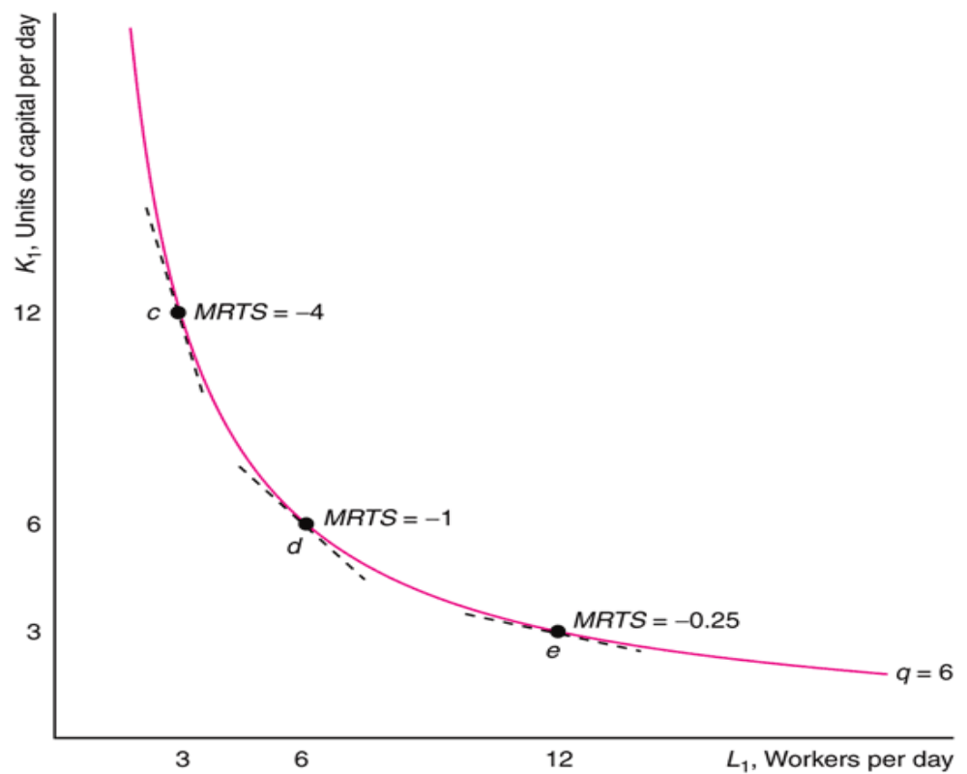
Long-Run Production

Slide 32
Long-Run Production
For most isoquants, the MRTS is not constant.
As we increase capital and decrease labour, at what rate does the
MRTS change?
This is the elasticity of substitution... A measure of how "curvy"
our isoquants are

Slide 33
Returns to Scale
If we increase our inputs proportionately, what happens to our output?
This is called returns to scale
We can have increasing, decreasing or constant returns to scale.
If doubling our inputs leads to exactly double the output, we have
constant returns to scale
2f (L,K) = f (2L, 2K)

Slide 34
Returns to Scale
If doubling our inputs leads to more than double the output, we have
increasing returns to scale
2f (L,K) < f (2L, 2K)
Could be caused by greater specialization

Slide 35
Returns to Scale
Constant Returns to Scale (CRS): f(2L, 2K) = 2f(L,K) = 2q
  A technology exhibits constant returns to scale if doubling inputs exactly doubles the output. The firm builds an identical second plant and uses the same amount of labor and equipment as in the first plant.
Increasing Returns to Scale (IRS): f(2L, 2K) > 2f(L,K) = 2q
  A technology exhibits increasing returns to scale if doubling inputs more than doubles the output. Instead of building two small plants, the firm decides to build a single larger plant with greater specialization of labor and capital.
Decreasing Returns to Scale (DRS): f(2L, 2K) < 2f(L,K) = 2q
  A technology exhibits decreasing returns to scale if doubling inputs less than doubles output. An owner may be able to manage one plant well but may have trouble organizing, coordinating, and integrating activities in two plants.

Slide 36
Returns to Scale
Varying Returns to Scale
  Many production functions have increasing returns to scale for small amounts of output, constant returns for moderate amounts of output, and decreasing returns for large amounts of output.
Graphical Analysis
  Figure next slide shows, a to b: When a firm is small, increasing labor and capital allows for gains from cooperation between workers and greater specialization of workers and equipment, so there are increasing returns to scale
  Figure next slide shows, b to c: As the firm grows, returns to scale are eventually exhausted. There are no more returns to specialization, so the production process has constant returns to scale.
  Figure next slide shows, c to d: If the firm continues to grow, the owner starts having difficulty managing everyone, so the firm suffers from decreasing returns to scale.

Slide 37
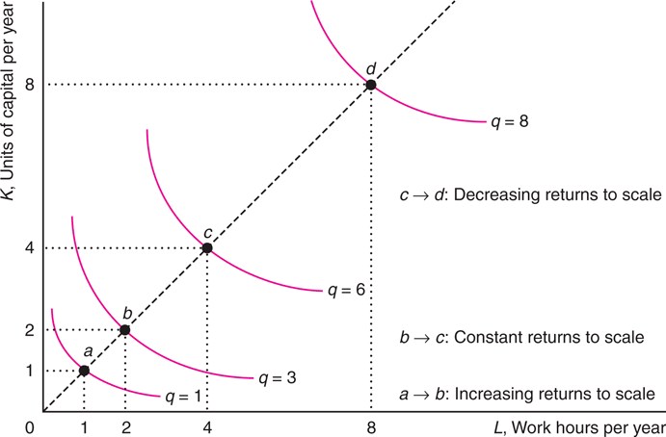
Varying Scale Economies

Slide 38
Marginal, Average and Total Product
Example
Consider a production function as follows: Q = 6*𝐾^2*𝐿^2 − 0.10*𝐾^3*𝐿^3, where Q is the total output produced, and K and L the two factors of production. With factor K fixed at 10 units, determine
a) The total product function for factor L (TPL)
Solution
TPL = 6*(10)^2*𝐿^2 − 0.10*(10)^3*𝐿^3, = 600*L^2 − 100*L^3
b) The marginal product function for factor L (MPL)
Solution
MPL = 𝑑 𝑇𝑃𝐿-𝑑𝐿 = 1200L – 300L^2

Slide 39
Marginal, Average and Total Product
c) The average product function for factor L (APL)
Solution
APL = 𝑇𝑃𝐿 /𝐿 = 600𝐿^2− 100𝐿^3/𝐿 = 600𝐿− 100𝐿2
d) Number of units of input L that maximizes TPL
Solution
𝑑 𝑇𝑃𝐿 /𝑑𝐿 = 0
1200𝐿− 300𝐿2 = 0
L (1200 - 300L) = 0 (Its also true that 1200 – 300L = 0 and L = 0)

Slide 40
Marginal, Average and Total Product
Therefore L is 0 and 4
Checking for second order condition for maximisation, i.e., 𝑑^2 𝑇𝑃𝐿 /𝑑𝐿^2 > 0 we get L = 4 that maximizes TPL.
600L^2 − 100L^3 = 1200L – 300L^2 =1200 – 600L (1200 – 600L = 0, the ans is L = 2)

Slide 41
Marginal, Average and Total Product
e) Number of units of input L that maximises MPL
Solution
𝑑 𝑀𝑃𝐿 /𝑑𝐿^2 = 0
1200 – 600 L = 0 ⇒ L = 2 maximises MPL
f) Number of units of input L that maximises APL
Solution
𝑑 𝐴𝑃𝐿/ 𝑑𝐿 = 0
600 – 200 L = 0 ⇒ L = 3 maximises APL

Slide 42
Marginal, Average and Total Product
g) The boundaries for the three stages of production.
Solution
Stage I: Labour units 0 - 3, Begins from origin till the point where APL reaches its maximum.
Stage II: Labour units 3 - 4, begins at point where APL reaches its maximum till the point when MPL reduces to 0 with TPL reaching its maximum.
Stage III: Labour units 4 - ∞, begins at point where MPL = 0 till the point where MPL < 0

Slide 43
Marginal, Average and Total Product
h) The point at which MPL = APL is given by
1200L – 300L^3 = 600𝐿+100𝐿^2
600L - 100𝐿^2 - 300L^3 = 0
L (600 – 100L - 300L^2) = 0
- 300L2 – 100L + 600 = 0
𝐿=[−𝑏± Sqr(𝑏^2−4𝑎𝑐)]/2𝑎
L = [−(−100) ± Sqr(−100^2 − 4 (−300)(600)]/2 (−300)
L = [− (−100) ± 10,000+720,000]/2 (−300)
L = [− (−100) ± 10,000+720,000]/2 (−300)
L = [100 ± 730,000]/−600
L = [100 ± 854.4003]/−600
L = − 954.4003−600 or − 754.4003−600
L = 1.591 or 1.257

Slide 44
Cost analysis: fixed costs, variable costs, and total costs
Formulas to Use
Total Revenue (TR) = P (Price) x (quantity) Q
Marginal Revenue (MR) = Δ𝑇𝑅/Δ𝑄 = 𝑑𝑇𝑅/𝑑𝑄
Average Revenue (AR) = 𝑇𝑅𝑄
Total Cost (TC) = FC + VC
Average Total Cost (ATC) = 𝑇𝐶𝑄
Average Fixed Cost (AFC) = 𝐹𝐶𝑄
Average Variable Cost (AVC) = 𝑉𝐶𝑄
Marginal Cost (MC) = Δ𝑇𝐶/Δ𝑄 = 𝑑𝑇𝐶/𝑑𝑄
Profit (λ) = TR - TC

Slide 45
Table with solved answers
Output (Q) Price (P) TR = PQ MR = Δ𝑇𝑅/Δ𝑄 TC = FC + VC ATC = 𝑇𝐶/𝑄 MC = Δ𝑇𝐶/Δ𝑄 Profit λ = TR - TC
0 14 0 - 2 - - -2
1 12 12 12 6 6 4 6
2 10 20 8 8 4 2 12
3 8 24 4 12 4 4 12
4 6 24 0 20 5 8 4
5 4 20 -4 35 7 15 -15

Slide 46
Profit maximization and the relationship between costs and revenue
The Profit Maximization Rule states that if a firm chooses to maximize its profits, it must choose that level of output where Marginal Cost (MC) is equal to Marginal Revenue (MR) and the Marginal Cost curve is rising. In other words, it must produce at a level where MC = MR.
The profit maximization rule formula is
MC = MR

Slide 47
Profit maximization and the relationship between costs and revenue
Marginal Cost is the increase in cost by producing one more unit of the good.
Marginal Revenue is the change in total revenue as a result of changing the rate of sales by one unit. Marginal Revenue is also the slope of Total Revenue.
Profit = Total Revenue – Total Costs
Therefore, profit maximization occurs at the most significant gap or the biggest difference between the total revenue and the total cost.
Why is the output chosen at MC = MR?

Slide 48
Why does profit maximisation occur where MC = MR
1. Profit = revenue - cost
2. As you sell more, profit will grow as long as the extra revenue obtained is greater than the extra cost incurred (extra revenue = MR, extra cost = MC).
3. MR is constant or falls, and MC may fall initially but quickly rises.
4. This means that they will soon cross if plotted on the same graph.
5. Before they cross MR is greater than MC and each extra unit will increase total revenue. However, once they have crossed MC is greater than MR and then each unit will reduce total profit (as more is being added to cost than revenue).
6. Therefore maximum profit is where MR and MC cross.

Slide 49
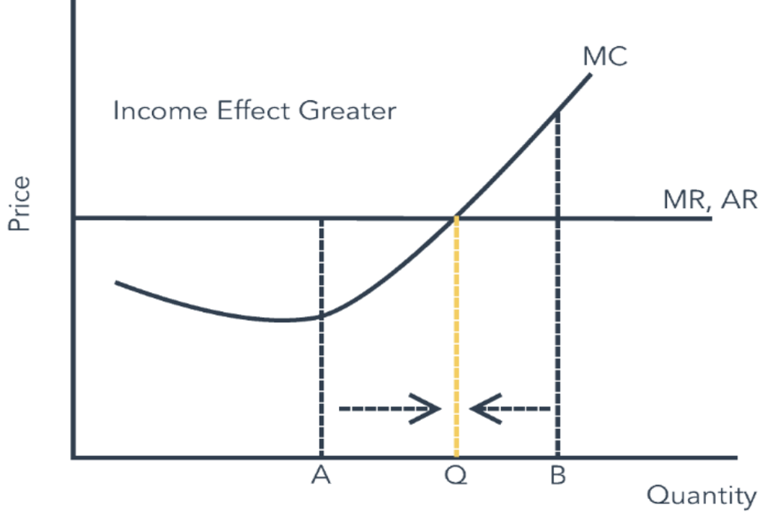
Profit maximization and the relationship between costs and revenue

Slide 50
Profit maximization and the relationship between costs and revenue
At A, Marginal Cost < Marginal Revenue, then for each additional unit produced, revenue will be higher than the cost so that you will generate more.
At B, Marginal Cost > Marginal Revenue, then for each extra unit produced, the cost will be higher than revenue so that you will create less.
Thus, optimal quantity produced should be at MC = MR Distinction between Short and Long-Term.

Slide 51
Example
James owns a small, perfectly competitive, fast-food restaurant in downtown Kabwe. The market price of the food is ZMW20. James‟s total cost is as follows:
TC = 1500 + 0.0025Q^2
Assume that the local government decides to impose a per-unit tax of ZMW2.50 Only on James‟s restaurant.
Find James’s after-tax output and profit.
Find James’ without tax output and profit

Slide 52
Solution
The total cost function and total revenue function
TC = 1500 + 0.0025Q^2 and TR = 20Q
The marginal cost function and marginal revenue function
MC = 0.005Q and MR = 20
The after-tax total cost function:
TC = 1500 + 0.0025Q^2 + 2.5Q
The after-tax marginal cost function:
MC = 0.005Q + 2.5
Profit is maximized at the point where “MR = MC”
20 = 0.005Q + 2.5
20 – 2.5 = 0.005Q
17.5 = 0.005Q
Q = 3,500

Slide 53
Solution
Profit = TR – TC
TR = P × Q = 20 × 3,500 = ZMW 70,000
TC = 1500 + 0.0025(3500)^2 + 2.5(3500) = 1500 + 30625 + 8750 = ZMW 40,875
Profit = TR – TC = 70,000 – 40,875 = ZMW 29,125

Slide 54
Find James‟s output and profit without tax.
TC = 1500 + 0.0025Q^2
Price (P) = 20
Mc = 0.005Q
TR = PQ = 20Q
MR = 20
MC = MR
0.005Q = 20
Q = 200.005 = 4000
Profit = TR –TC
Profit = PQ – (1500 +0.0025Q^2)
Profit = (20 x 4000) – (1500 +0.0025(4000)^2
Profit = 80,000 – 41500 = 38, 500

Slide 55
Market structures: perfect competition and monopoly
FEATURES OF PERFECT COMPETITION MARKET
Large Number of Buyers and Sellers:
Homogeneous Product and Uniform Price:
Perfect knowledge about market conditions
Free entry and Free exit :
Perfect mobility of factors of production:
Absence of transport cost:
Absence of Government intervention:

Slide 56
MONOPOLY
Monopoly is a market structure characterized by a single seller, selling the unique product with the restriction for a new firm to enter the market
FEATURES OF MONOPOLY MARKET
Single Seller:
No close Substitutes:
Price:
N o Entry:
Firm and Industry:

Slide 57
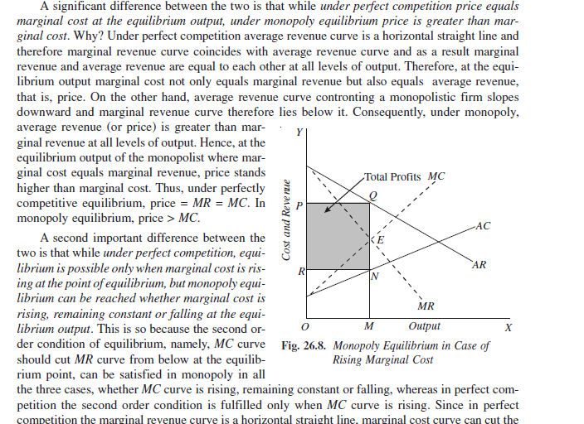
Market structures: perfect competition and monopoly

Slide 58
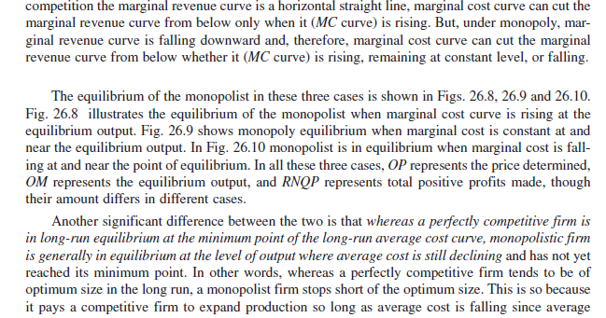
Market structures: perfect competition and monopoly

Slide 59
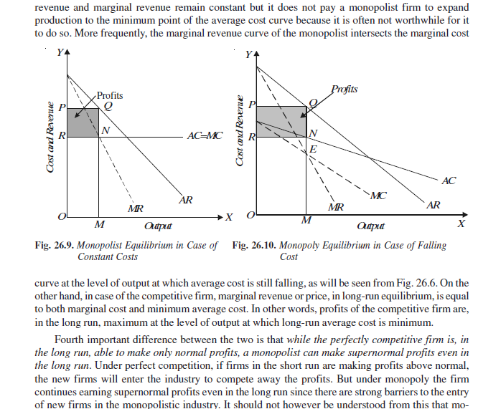
Market structures: perfect competition and monopoly

Slide 60
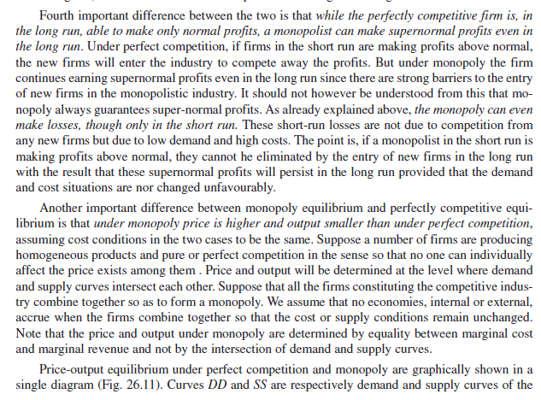
Market structures: perfect competition and monopoly

Slide 61
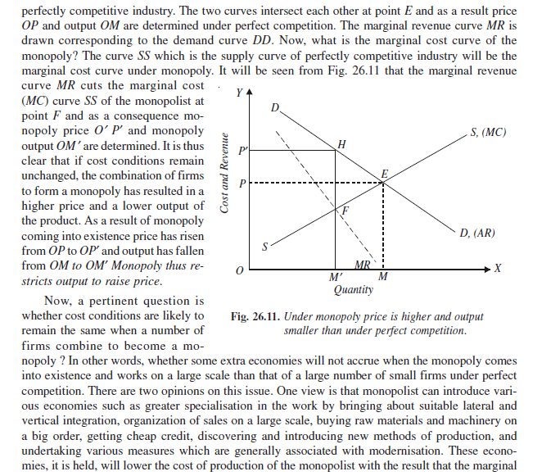
Market structures: perfect competition and monopoly

Slide 62
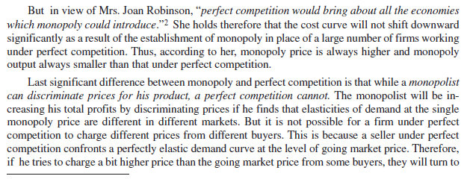
Market structures: perfect competition and monopoly

Slide 63
Pricing strategies and the impact of market power
PRICE DISCRIMINATION UNDER MONOPOLY
This is called price discrimination practiced by the monopolist. Under this, the monopolist will charge different prices from different class of customers. The idea is to get from each customer whatever profits could be squeezed out of him depending on his purse and intensity of demand.
Types of Price Discrimination
1. Personal Discrimination: The monopolist will charge different prices from different customers on the basis of their ability to pay. Rich customers will be asked to pay more and poor customers to pay less. This is possible in specialized services of doctors and lawyers.
2. Place Discrimination: It is adopted by the monopolist having markets in different places for the same commodity. The locality in which the market is situated will be the criterion in fixing up the price.
3. Trade discrimination: It can also be called use discrimination. By this, the monopolist will charge different prices for different types of uses of the same commodity. For example, electricity will be sold at a cheaper rate for industrial establishment, while it will be charged at a higher rate for domestic consumption

Slide 64
Pricing strategies and the impact of market power
In Perfect Competition Market: Strategy Firms are price-takers, meaning they have no control over the market price
Price Determination: Price is determined by the intersection of the market demand and supply curves
Price Determination: Price is determined by the monopolist's profit-maximizing output level
Strategy: Monopolist can set the price, but is limited by the demand curve

Slide 65
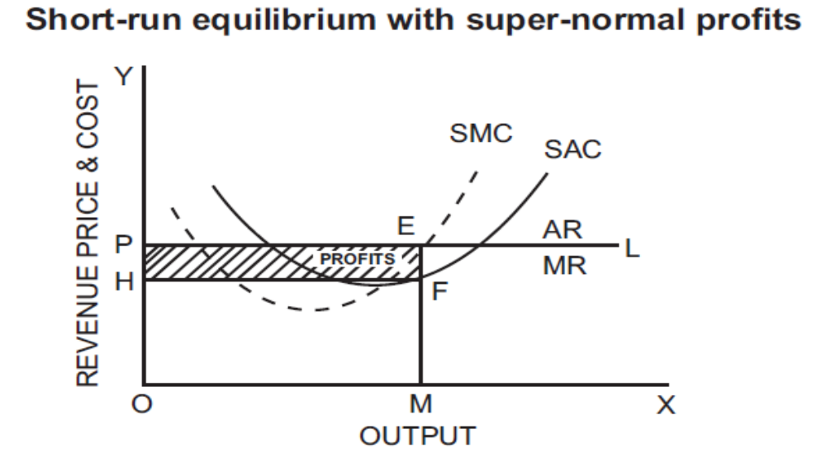
Profit and revenue in different market structures
SUPER-NORMAL PROFIT
When the average revenue of the firm is greater than its average cost, the firm is earning super-normal profit.
In

Slide 66
Profit and revenue in different market structures
In above figure, output is measured along the x-axis and price, revenue and cost along the y-axis.
OP is the prevailing price in the market. PL is the demand curve or average and the marginal revenue curve. SAC and SMC are the short run average and marginal cost curves.
The firm is in equilibrium at point ‘E’ where MR = MC and MC curve cuts MR curve from below at the point of equilibrium. Therefore the firm will be producing OM level of output. At the OM level of output ME is the AR and MF is the average cost.
The profit per unit of output is EF (the difference between ME and MF). The total profits earned by the firm will be equal to EF (profit per unit) multiplied by OM or HF (total output). Thus the total profits will be equal to the area HFEP. HFEP is the supernormal profits earned by the firm

Slide 67
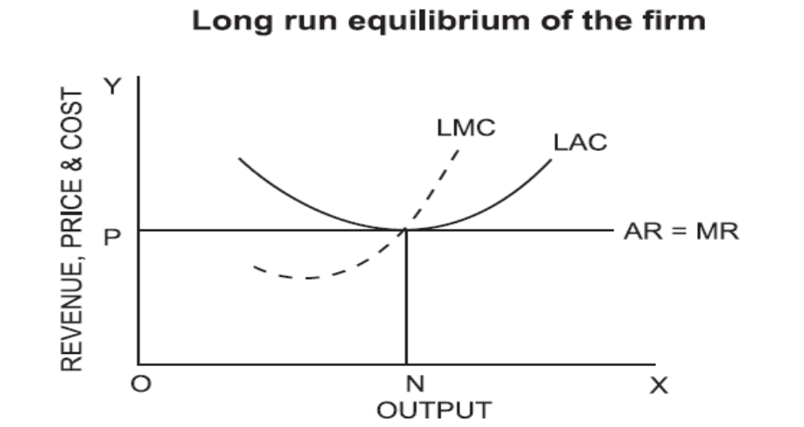
LONG RUN EQUILIBRIUM, PRICE AND OUTPUT DETERMINATION UNDER PERFECT COMPETITION

Slide 68
LONG RUN EQUILIBRIUM, PRICE AND OUTPUT DETERMINATION UNDER PERFECT COMPETITION
Above figure represents long run equilibrium of firm under perfect competition. The firm is in equilibrium at point S where LMC = MR = AR = LAC. The long run equilibrium output is ON.
The firm is earning just the normal profit. The equilibrium price is OP. If the price rises above OP, the firm will earn abnormal profit, which will attract new firms into the industry. If the price is less than OP, there will be loss and the tendency will be to exit.
So in the long run equilibrium, OP will be the price and marginal cost will be equal to average cost and average revenue. Thus the firm in the long run will earn only normal profit.
Competitive firms are in equilibrium at the minimum point of LAC curve. Operating at the minimum point of LAC curve signifies that the firm is of optimum size i.e. producing output at the lowest possible average cost.

Slide 69
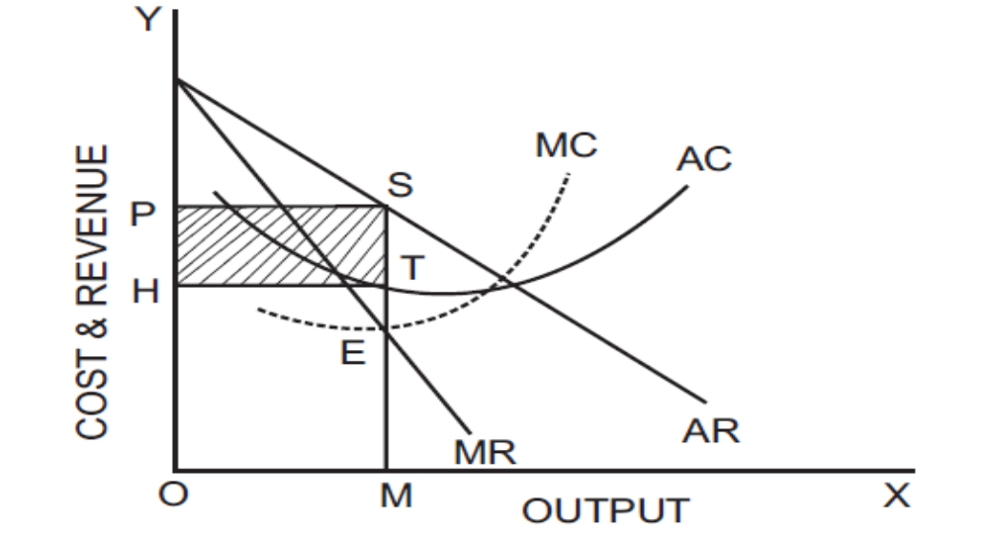
MONOPOLY
A monopolist like a perfectly competitive firm tries to maximize his profits. A monopoly firm faces a downward sloping demand curve, that is, its average revenue curve. The downward sloping demand curve implies that larger output can be sold only by reducing the price

Slide 70
MONOPOLY
In the above figure, AR is the Average Revenue Curve and MR is the Marginal revenue curve. AR curve is falling and MR curve lies below AR. The monopolist is in equilibrium at E where MR = MC. He produces OM units of output and fixes price at OP. At OM output, the average revenue is MS and average cost MT. Therefore the profit per unit is MS-MT = TS. Total profit is average profit (TS) multiplied by output (OM), which is equal to HTSP. The monopolist is in equilibrium at point E and produces OM output at which he is earning maximum profit. The monopoly price is higher than the marginal revenue and marginal cost

Slide 71
Economies of scale and scope in production
Economies’ mean advantages. Scale refers to the size of unit. ‘Economies of Scale’ refers to the cost advantages due to the larger size of production.
As the volume of production increases, the overhead cost will come down. The bulk purchase of inputs will give a better bargaining power to the producer which will reduce the average variable cost too.
All these advantages are due to the large scale production and these advantages are called economies of scale.

Slide 72
Types of Economies of Scale
Internal Economies of Scale
Technical Economies: As the size of the firm is large, the availability of capital is more. Due to this, a firm can introduce up- to-date technologies.
Financial Economies: It is possible for big firms to float shares in the market for capital formation. Small firms have to borrow capital whereas large firms can buy capital.
Managerial Economies: Division of labour is the result of large scale production. Right person can be employed in the right department only if there is division of labour.

Slide 73
Types of Economies of Scale
Labour Economies: Large Scale production paves the way for division of labour. This is also known as specialization of labour. The specialization will increase the quality and ability of the labour. As a result, the productivity of the firm increases
Marketing Economies: In production, the first buyer is the producer who buys the raw materials. As the size is large, the quantity bought is larger. This gives the producer a better bargaining power.
Economies of survival: A large firm can have many products. Even if one product fails in the market, the loss incurred in that product can be managed by the profit earned from the other products.

Slide 74
Types of Economies of Scale
2. External economies of scale:
When many firms expand in a particular area – i.e., when the industry grows – they enjoy a number of advantages which are known as external economies of scale. This is not the advantage enjoyed by a single firm but by all the firms in the industry due to the structural growth. They are
a) Increased transport facilities
b) Banking facilities
c) Development of townships
d) Information and communication development
All these facilities are available to all firms in an industrial region.

Slide 75
DISECONOMIES OF SCALE
These diseconomies are of two types:
a) Internal Diseconomies of Scale: and
b) External Diseconomies of Scale

Slide 76
Technological advancements and their influence on production
Relative Productivity
  Firms are not necessarily equally productive
  A firm may be more productive than others if: a manager knows a better way to organize production; it’s the only firm with access to a new invention; union-mandated work rules, government regulations, or other institutional restrictions affect only competitors.
  Firms are equally productive in competitive markets, not in oligopoly markets
Innovations and their role in business strategies
  An advance in knowledge that allows more output to be produced with the same level of inputs is called technological progress.
  Technological progress is neutral if more output is produced using the same ratio of inputs. It is nonneutral if it is capital saving or labor saving.
  Organizational changes may also alter the production function and increase the amount of output produced by a given amount of inputs. In the early 1900s, Henry Ford revolutionized mass production of automobiles through interchangeable parts and the assembly line.

Slide 77
Labor markets and the economic implications of wage differentials
Wages are a payment for the services of labour, whether intellectual or physical. Wage may be paid daily, weekly, fortnightly, monthly or yearly and partly at the end of the year in the form of bonus.
Wage is the price paid to the labourer for the services rendered. According to Benham, wage is “A sum of money paid under contract by an employer to a worker for the services rendered”.

Slide 78
KINDS OF WAGES
1. Nominal Wages or Money Wages: Nominal wages are referred to the wages paid in terms of money.
2. Real Wages: Real wages are the wages paid in terms of goods and services. Hence, real wages are the purchasing power of money wages.
3. Piece Wages: Wages that are paid on the basis of quantum of work done.
4. Time Wages: Wages that are paid on the basis of the amount of time that the worker works firms of money.

Slide 79
THE SUBSISTENCE THEORY OF WAGES
Subsistence theory is one of the oldest theories of wages. It was first explained by Physiocrats, a group of French economists and restated by Ricardo.
According to this theory, wage must be equal to the subsistence level of the labourer and his family. Subsistence means the minimum amount of food, clothing and shelter which workers and their family require for existence.
If workers are paid higher wages than the subsistence level, the workers would be better off and they will have large families. Hence, the population would increase. When the population increases, the supply of labourer would increase and therefore, wages will come down.
On the other hand, if wages are lower than the subsistence level, there would be a reduction in population and thereby the supply of labour falls and wages increase to the subsistence level. So this theory is closely associated with Malthusian Theory of Population

Slide 80
STANDARD OF LIVING THEORY OF WAGES
The Standard of Living Theory of Wages developed by Torrance is an improved and refined version of the Subsistence Theory of Wage.
According to this theory, wage is equal to the standard of living of the workers. If standard of living is high, wages will be high and vice versa.
Standard of living wage means the amount necessary to maintain the labourer in the standard of life to which he is accustomed

Slide 81
THE WAGE FUND THEORY OF WAGES
This theory was first propounded by Adam Smith. But the credit goes to J.S.Mill who perfected this theory.
According to Wages Fund Theory, “wages depend upon the proportion between population and capital”. The term “capital” in the context refers to the fund set apart for payment of wages. And the word ‘population’ refers to workers.
Implication economy :If the supply of workers increases, wages will fall and vice versa.

Slide 82
THE RESIDUAL CLAIMANT THEORY OF WAGE
This theory was propounded by the American economist F.A.Walkar in 1875, in his book Political Economy.
According to this theory, wages “equal the whole product minus rent, interest and profits” (Walker). In other words, the theory tells that wages are paid out of the residue that is left over after making payment for rent, interest and profits.

Slide 83
MARGINAL PRODUCTIVITY THEORY OF WAGE
The application of general theory of distribution to wage fixation is the marginal productivity theory of wages.
According to the theory wages are determined by the marginal productivity of labour and equal to it at the point of equilibrium.
Under perfect competition wage is paid equal to marginal product of labour (wage = MPL) But in real world where there is imperfect competition, there is exploitation of labour and wage is less than MPL.

Slide 84
THE BARGAINING THEORY OF WAGES
The bargaining theory of wages takes note of the influence of trade unions on wages through collective bargaining.
According to the theory, the level of wages in an industry depends on the bargaining strength of the trade union concerned.
The strength of a trade union depends upon many things like the size of its membership, the size of its “fighting fund”, and its ability to cause dislocation in the industry and the economy through strike sacrifice their earnings.
We have to take note of the foregone earnings while estimating the cost of labour which determines its supply

Slide 85
THE MARKET THEORY OF WAGES
The market theory looks at wages as the price of labour. Like all other prices, wages are determined by the market forces of supply and demand.
The supply of labour generally refers to the total number of people available for employment. Some types of labour require long periods of training. During that long period, workers have to

Slide 86
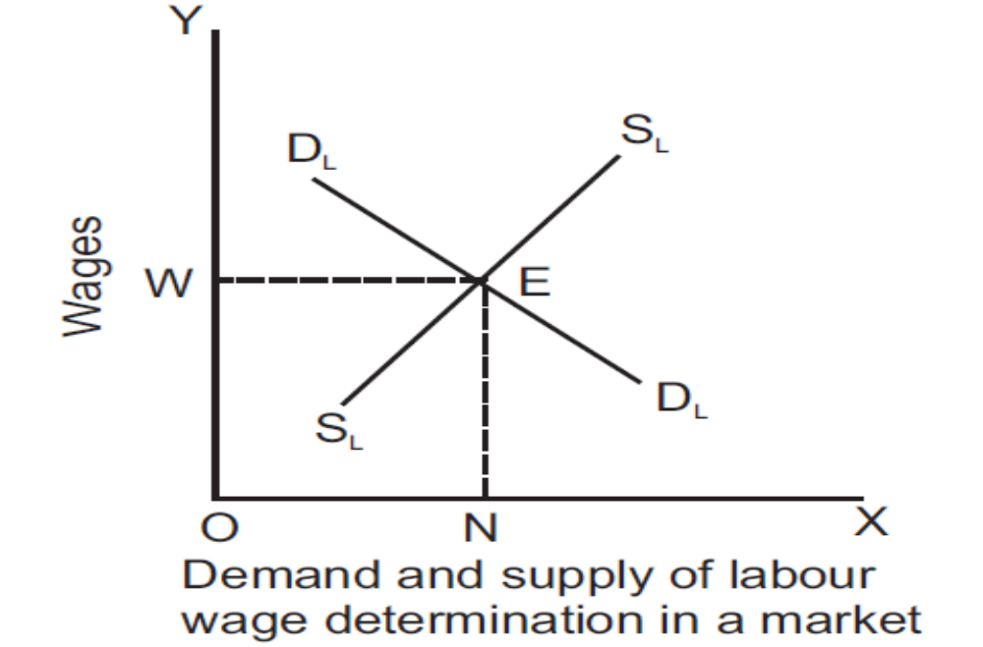
Diagram of determination of wages in a market

Slide 87
Managerial Problem & Solution
Managerial Problem
  Labor productivity during recessions
  How much will the output produced per worker rise or fall with each additional layoff?
Solution
  Layoffs have the positive effect of freeing up machines to be used by remaining workers. However, if layoffs force the remaining workers to perform a wide variety of tasks, the firm will lose the benefits from specialization.
  Holding capital constant, a change in the number of workers affects a firm’s average product of labor. Labor productivity could rise or fall.
  For some production functions layoffs always raise labor productivity because the AP_{L} curve is everywhere downward sloping, for instance the Cobb-Douglass production function.

